Slide 1
Types of DW Modelling
Sarthak Nagpal

Slide 2
Agenda
Introduction
Inmon Modelling
Kimball Modelling
Data Vault Modelling
Comparison

Slide 3
Introduction
Data warehouse is a centralized data repository designed specifically for OLAP.
Data is extracted from multiple sources, transformed into a common format, and loaded into the data warehouse for analysis (ETL process).
How you structure your data as an organization can have dramatic impact on innovation, employee efficiency, and overall data culture.

Slide 4
Inmon Modelling
Focuses on building a centralized, integrated data warehouse, also known as the “Enterprise Warehouse (Single source of truth).
Adopts 3NF normalized model to eliminate redundancy and ensure data consistency.
Data from various source systems is transformed and integrated before loading it into the data warehouse.
It’s well-suited for large organizations with complex data needs.

Slide 5
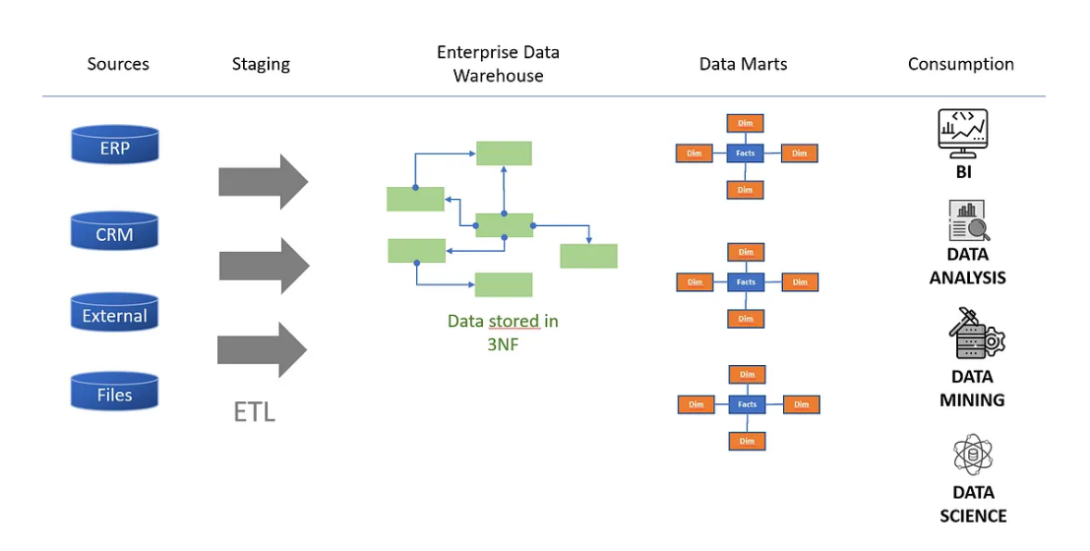
Inmon Modelling

Slide 6
Kimball Modelling
Focuses on creating data marts, which are subsets of a data warehouse.
It emphasizes aligning the data warehouse with business requirements with quick development.
Takes a less structured approach although future iterations require the same amount of work.
Leverages the star/snowflake schema for data marts which can then be joined together to gain inter- company insights.

Slide 7
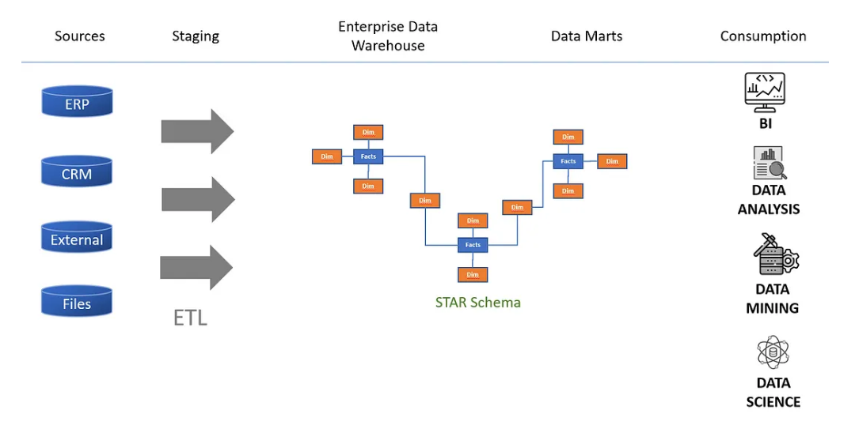
Kimball Modelling

Slide 8
Data Vault Modelling
Designed for agility and scalability, data is stored in its raw form, making it easy to add new sources and adapt to changing business needs.
Follows a hub-and-spoke architecture for modeling data ,focusing on creating separate entities for business processes, data sources.
Data vault is structured using hub,sats and links.
Highly dynamic, so if business logic changes the data infrastructure can easily adapt especially relationships.

Slide 9
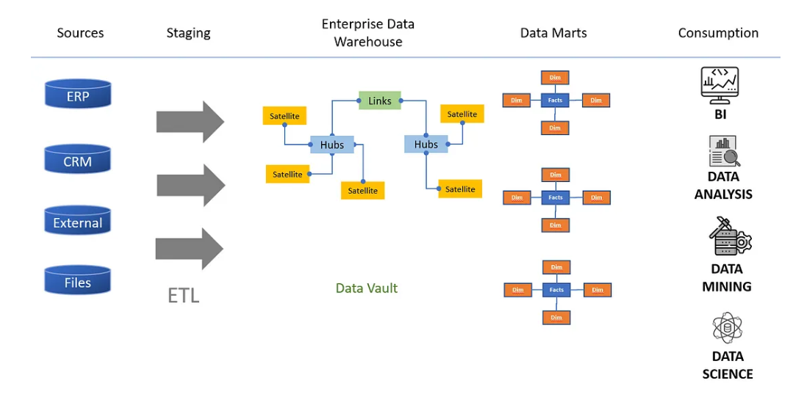
Data Vault Modelling

Slide 10
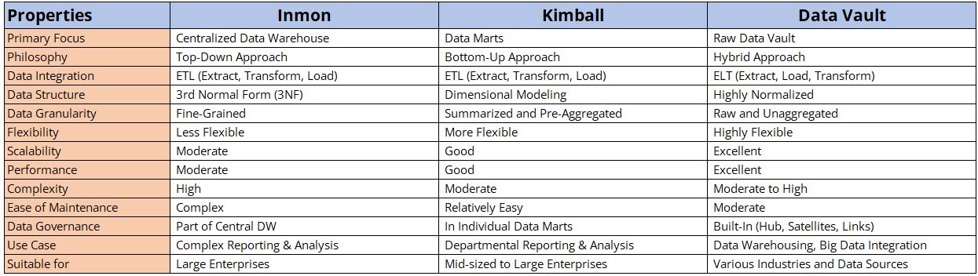
Comparison

Slide 11
Thank you

